Slide 1
ECE5584 – Digital Image Processing Homework 2, Problem 2 Fall 2019
By Matthew Kayrish

Slide 2

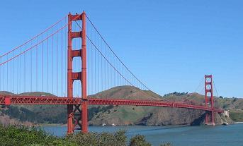
Problem 2: Filter Blurred Images
Original Images
Golden Gate Bridge
American Flag

Slide 3
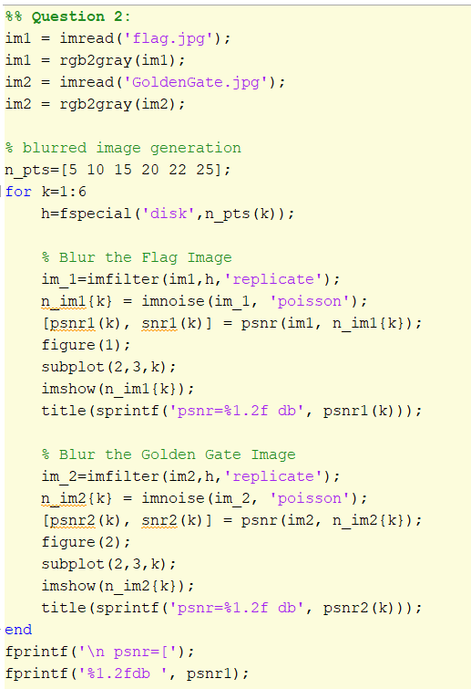
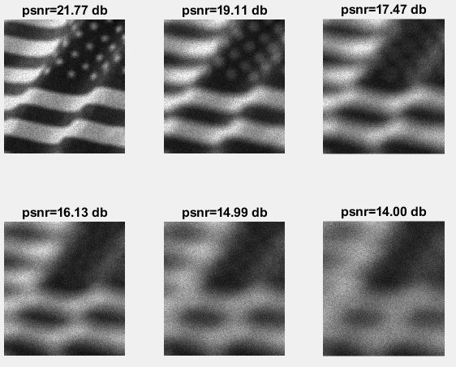
Problem 2: Filter Blurred Images
”Filter the noisy images generated using the following code.”
Step 1: Generate Blurred Images

Slide 4
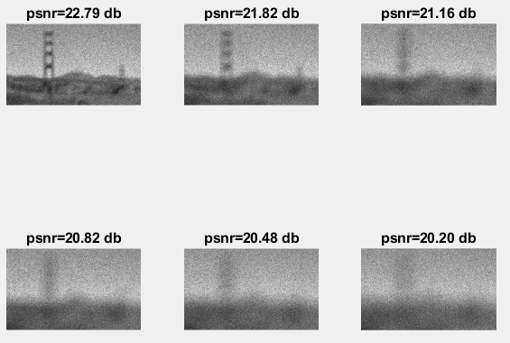
Problem 2: Filter Blurred Images
”Filter the noisy images generated using the following code.”
Step 1: Generate Blurred Images

Slide 5
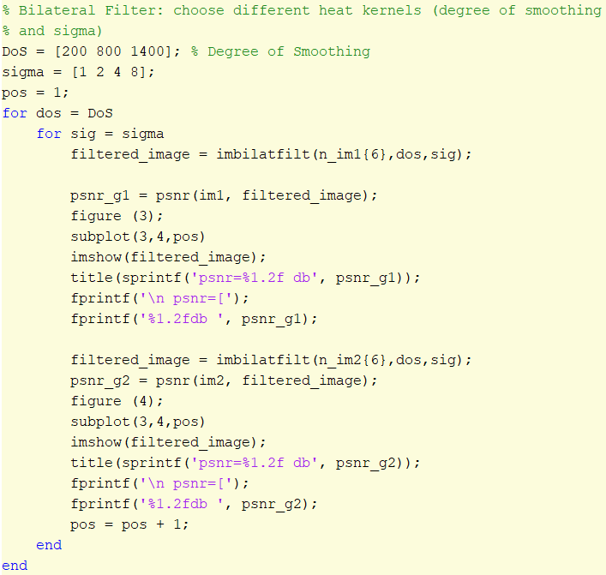
Problem 2: Filter Noisy Images
”(a) Use a Bilateral Filter (Choose Different Heat Kernels)”

Slide 6
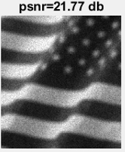
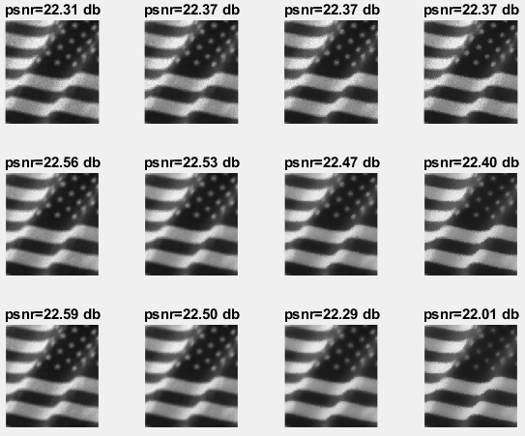
Problem 2: Before and After, Bilateral – 5 Pt. Blurring
After Filtering
Before Filtering
200 DoS
800 DoS
1400 DoS
Sigma: 1.0 2.0 4.0 8.0

Slide 7
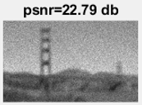
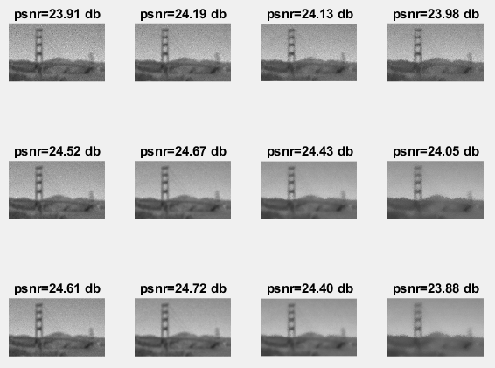
Problem 2: Before and After, Bilateral – 5 Pt. Blurring
After Filtering
Before Filtering
200 DoS
800 DoS
1400 DoS
Sigma: 1.0 2.0 4.0 8.0

Slide 8
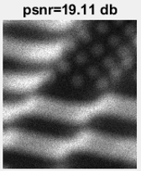
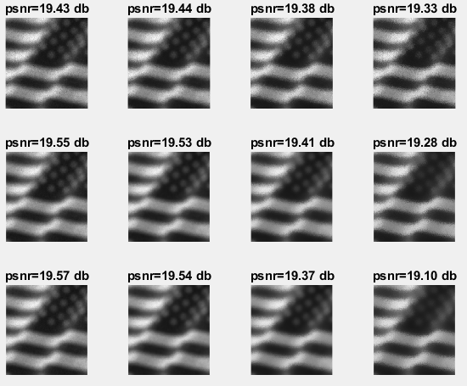
Problem 2: Before and After, Bilateral – 10 Pt. Blurring
After Filtering
Before Filtering
200 DoS
800 DoS
1400 DoS
Sigma: 1.0 2.0 4.0 8.0

Slide 9
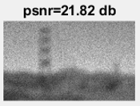
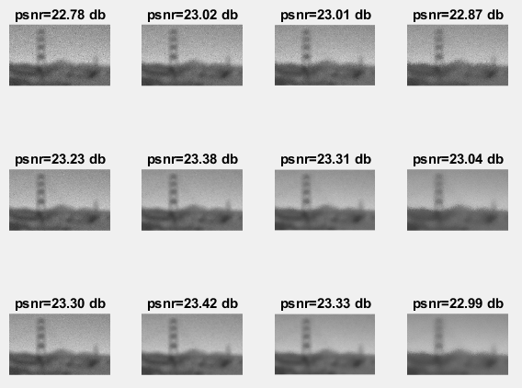
Problem 2: Before and After, Bilateral – 10 Pt. Blurring
After Filtering
Before Filtering
200 DoS
800 DoS
1400 DoS
Sigma: 1.0 2.0 4.0 8.0

Slide 10
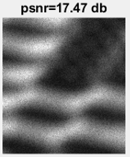
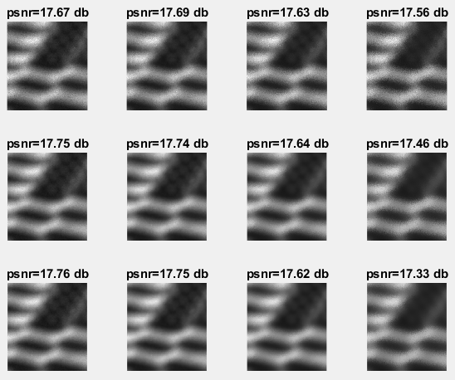
Problem 2: Before and After, Bilateral – 15 Pt. Blurring
After Filtering
Before Filtering
200 DoS
800 DoS
1400 DoS
Sigma: 1.0 2.0 4.0 8.0

Slide 11
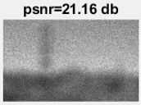
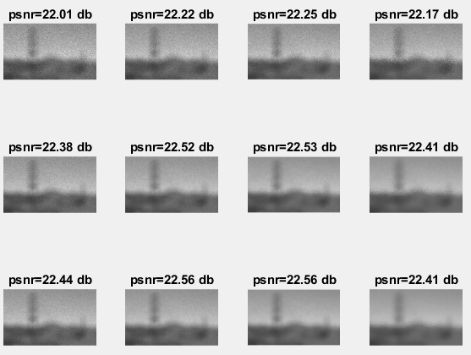
Problem 2: Before and After, Bilateral – 15 Pt. Blurring
After Filtering
Before Filtering
200 DoS
800 DoS
1400 DoS
Sigma: 1.0 2.0 4.0 8.0

Slide 12
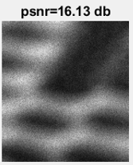
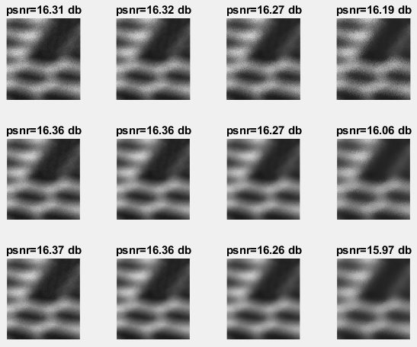
Problem 2: Before and After, Bilateral – 20 Pt. Blurring
After Filtering
200 DoS
Before Filtering
800 DoS
1400 DoS
Sigma: 1.0 2.0 4.0 8.0

Slide 13
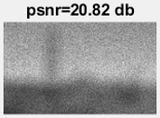
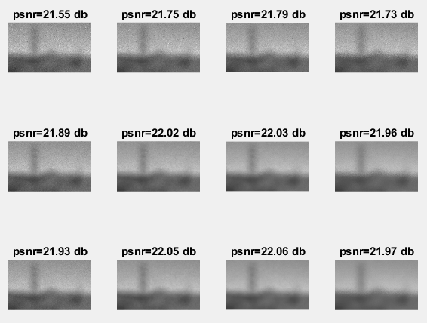
Problem 2: Before and After, Bilateral – 20 Pt. Blurring
After Filtering
Before Filtering
200 DoS
800 DoS
1400 DoS
Sigma: 1.0 2.0 4.0 8.0

Slide 14
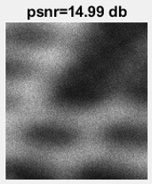
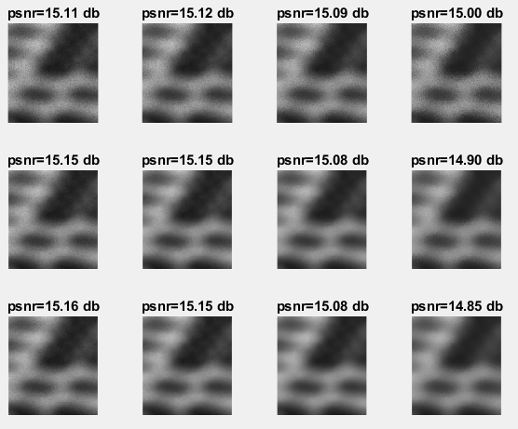
Problem 2: Before and After, Bilateral – 25 Pt. Blurring
After Filtering
200 DoS
Before Filtering
800 DoS
1400 DoS
Sigma: 1.0 2.0 4.0 8.0

Slide 15
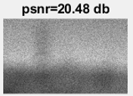
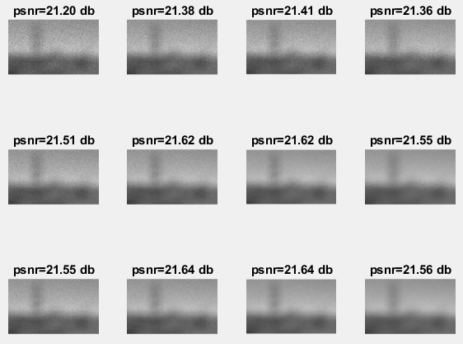
Problem 2: Before and After, Bilateral – 25 Pt. Blurring
After Filtering
Before Filtering
200 DoS
800 DoS
1400 DoS
Sigma: 1.0 2.0 4.0 8.0

Slide 16
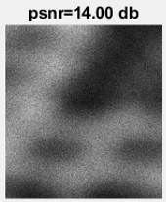
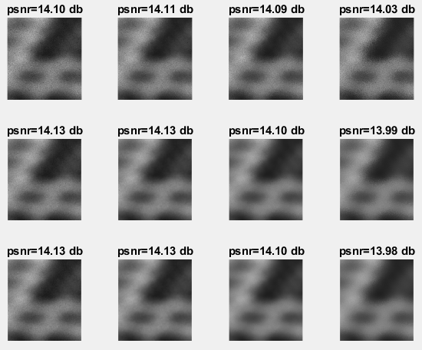
Problem 2: Before and After, Bilateral – 30 Pt. Blurring
After Filtering
200 DoS
Before Filtering
800 DoS
1400 DoS
Sigma: 1.0 2.0 4.0 8.0

Slide 17
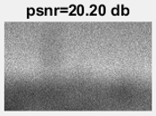
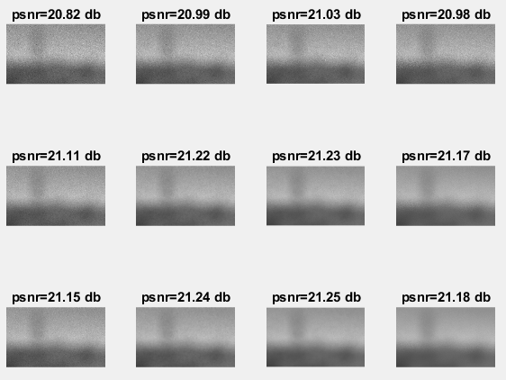
Problem 2: Before and After, Bilateral – 30 Pt. Blurring
After Filtering
Before Filtering
200 DoS
800 DoS
1400 DoS
Sigma: 1.0 2.0 4.0 8.0

Slide 18
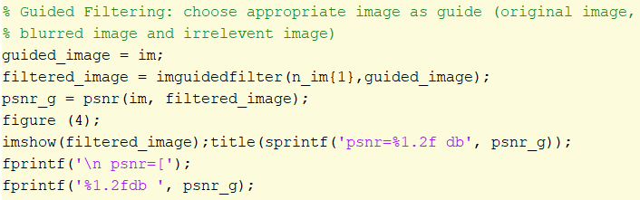
Problem 2: Filter Noisy Images
”(b) Use a Guided Image Filter”

Slide 19
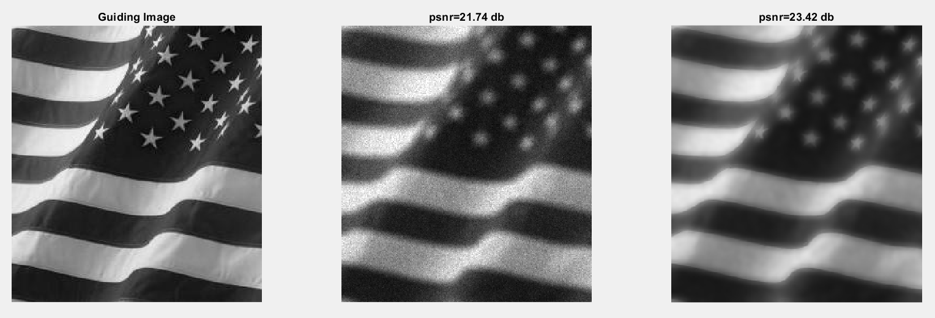
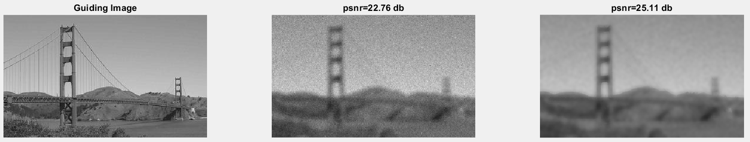
Problem 2: Guided Filter – Original Image, 5 Pt. Blurring

Slide 20
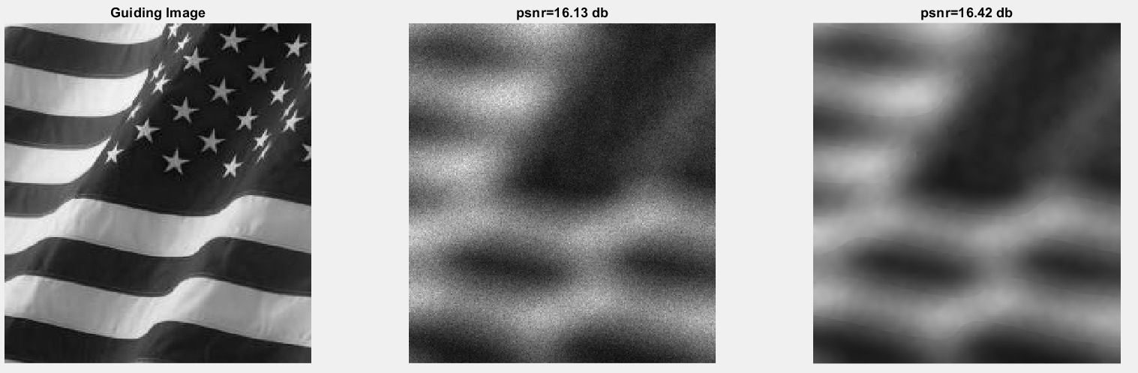

Problem 2: Guided Filter – Original Image, 20 Pt. Blurring

Slide 21
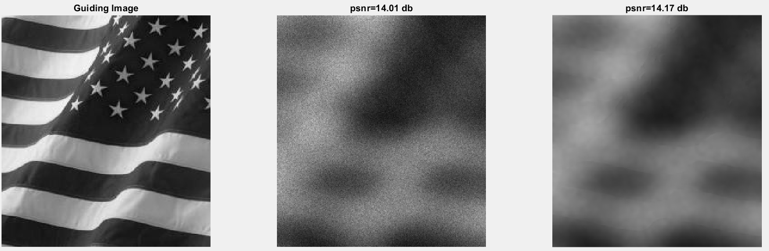
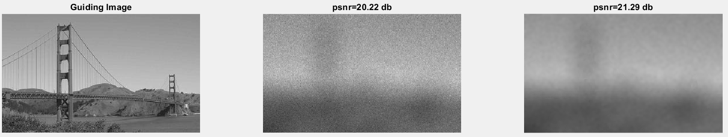
Problem 2: Guided Filter – Original Image, 30 Pt. Blurring

Slide 22
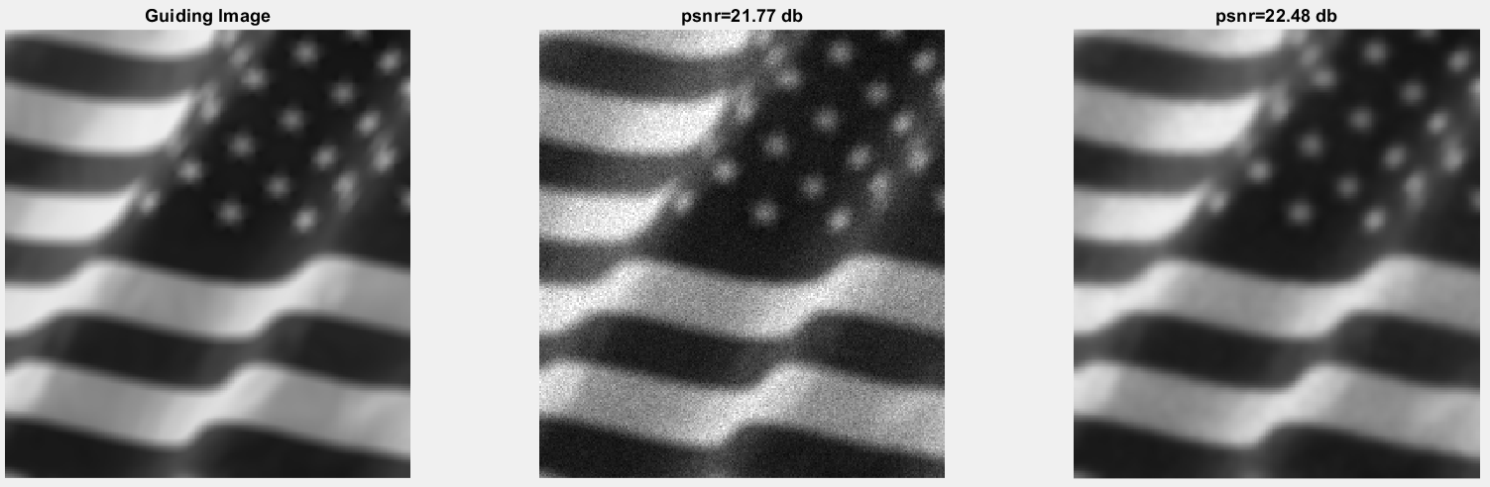

Problem 2: Guided Filter – Blurred, 5 Pt. Blurring

Slide 23
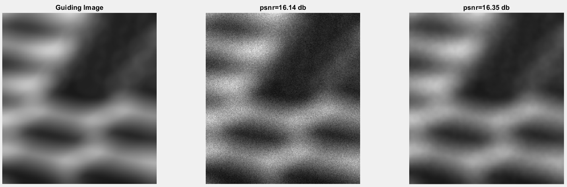
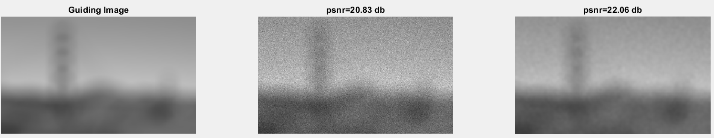
Problem 2: Guided Filter – Blurred, 20 Pt. Blurring

Slide 24

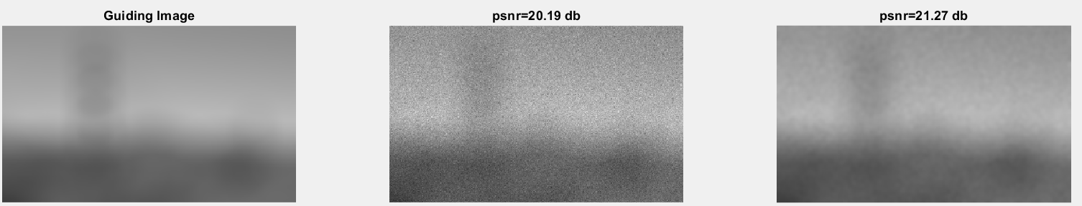
Problem 2: Guided Filter – Blurred, 30 Pt. Blurring

Slide 25

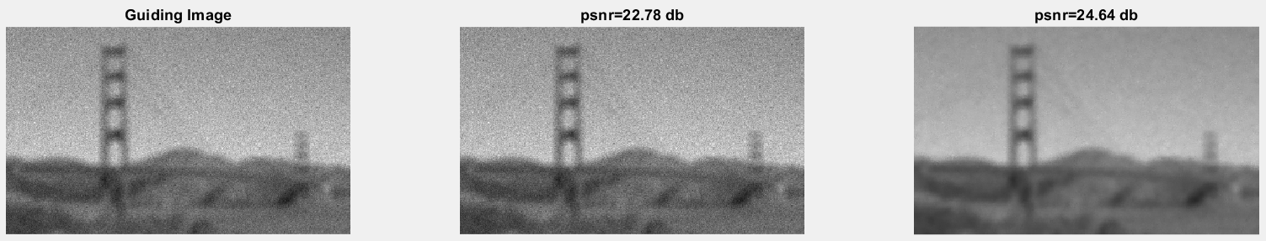
Problem 2: Guided Filter – Blurred and Noisy Image, 5 Pt. Blurring

Slide 26
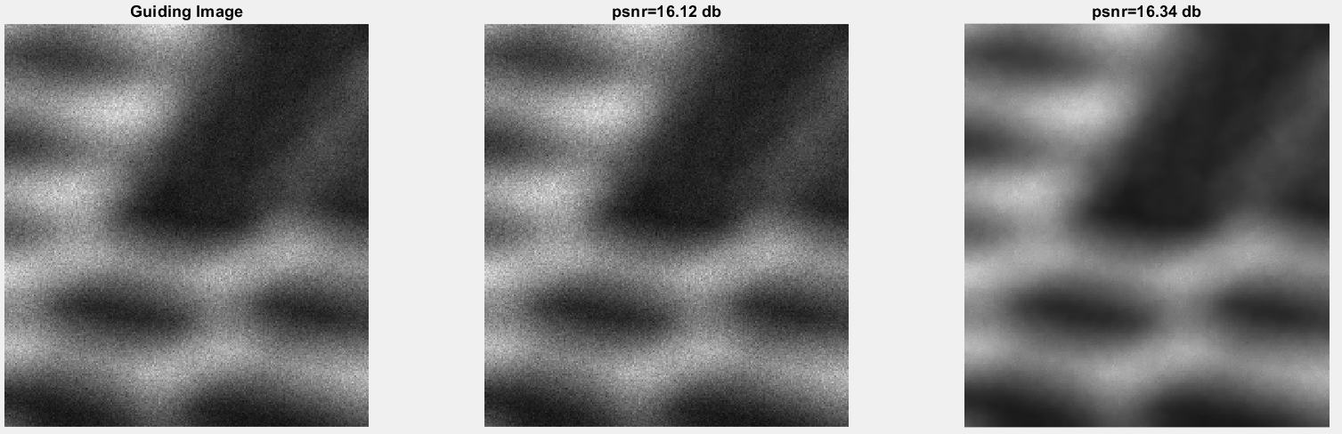
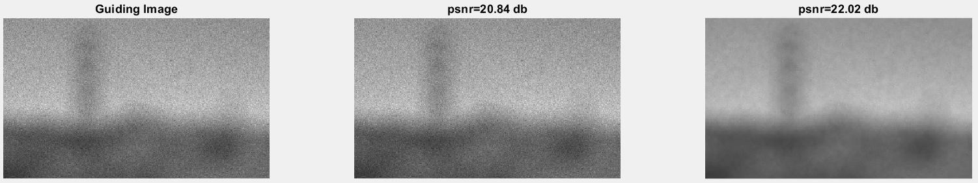
Problem 2: Guided Filter – Blurred and Noisy Image, 20 Pt. Blurring

Slide 27
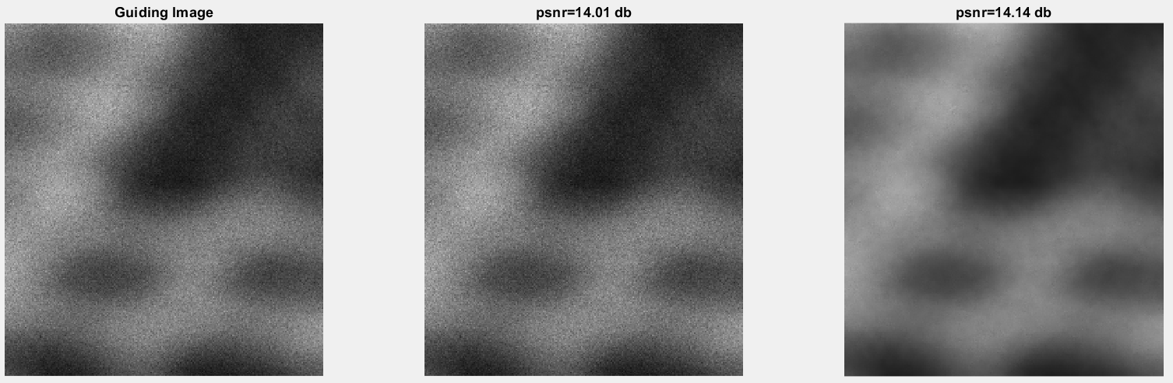
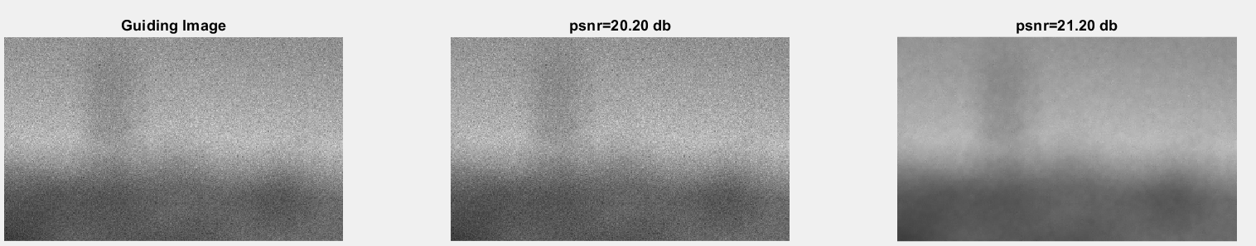
Problem 2: Guided Filter – Blurred and Noisy Image, 30 Pt. Blurring

Slide 28
Problem 2: Discussion – Bilateral Filtering
Degrees of Smoothing – the degrees of smoothing provides the extent to which the image will be ‘smoothed’ in regions of similar colors while providing some edge preservation.
As DoS increases, the smoothing effect will also increase.
As DoS decreases, the smoothing effect will be nearly negligible.
Sigma – the variance on the Gaussian filter within the Bilateral Filter will control the size of the neighborhood that the bilateral filter impacts.
Higher Sigma will capture a larger neighborhood, and therefore, provide for a greater smoothing effect.
Smaller Sigma will capture less of a neighborhood, and therefore, less smoothing will occur.

Slide 29
Problem 2: Discussion – Bilateral Filtering
Impact on Signal to Noise Ratio:
The Bilateral Filtering will generally achieve approximately the same SNR as the original image. In some cases, even better.
Full image recovery will typically not be possible with this type of filtering due to the smoothing effect.
Despite the improvement on SNR, the clarity of the image appears ‘smoothed’ together.
Edges lose sharpness.

Slide 30
Problem 2: Discussion – Guided Filter
Guided Filter – A filter that provides a baseline image that the filtering algorithm will strive to meet.
Guided Image – the baseline image that is used to guide the filtering process.
Input Image – the image being filtered.
Output Image – the result of the filtering process.

Slide 31
Problem 2: Discussion – Guided Filter
Original Image – the original input image is used as the guided image.
Generally produces a slightly better SNR improvement and recovery than the blurred image and the blurred noisy images
Performance will deteriorate as the ratio of blurriness increases.
Provides an effective smoothing effect.
Removes the ‘grittiness’ of the images effectively.

Slide 32
Problem 2: Discussion – Guided Filter
Blurred Image – the original input image is blurred with a disc filter, then used as the guided image.
Does not produce as significant a SNR as the original image.
Performance will deteriorate as the ratio of blurriness increases.
Provides a smoothing effect to the image.
Effective at removing ‘grittiness’ of the input image.

Slide 33
Problem 2: Discussion – Guided Filter
Blurred and Noisy Image – the original input image is blurred with a disc filter, noise is added, then used as the guided image.
Performs the worst of the three guided images.
Smallest SNR improvement.
Performance will deteriorate as the ratio of blurriness increases.
Provides a smoothing effect to the image.
Effective at removing ‘grittiness’ of the input image.

Slide 34
Problem 2: Comparison
Bilateral Filter
Guided Filter
Higher Degree of Smoothing will filter the noise more effectively.
Larger sigma will blur the edges.
Produces a good SNR improvement.
Despite the SNR improvement, it does not produce a sharpening effect.
Images are smoothed out and grittiness is removed.
Original image as guided image performs best.
Blurred and noisy images as guided image performs the worst.
Produces SNR improvement in all cases.
Does not improve the sharpness of the image.
Increases the smoothness and removes grittiness of image.

